Slide 1

Car Price Prediction
Name: NITIN SINGH TATRARI
BATCH: 1826

Slide 2
Problem Statement
Since the pandemic and economic slowdown, trend of buying used car has accelerated. The used car segment bounced back up to 99% in the aftermath of the lockdowns, as opposed to the new car segment which recovered only up to 77%. . It is estimated to sales 8.2 million cars in FY25, double than new cars. Almost half of all used car sales will come from organized dealers in FY25.
Although sales of used car have overtook those of new cars some years ago, but current economic scenario have further boast the trend that there demand-supply gap in the market. Due to this demand-supply gap, our client is facing problems with their previous car price valuation machine learning models. Even with the launch of many new companies in India and various new models, it’s hard to evaluate the price.
Thus, we are trying to develop a model to predict pricing of used cars by using different variables such as brand, model, variant, manufacturing year, driven kilometres, number of owners, location, fuel type and transmission type.

Slide 3
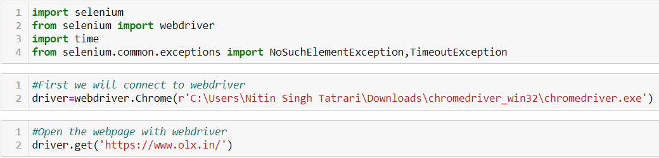
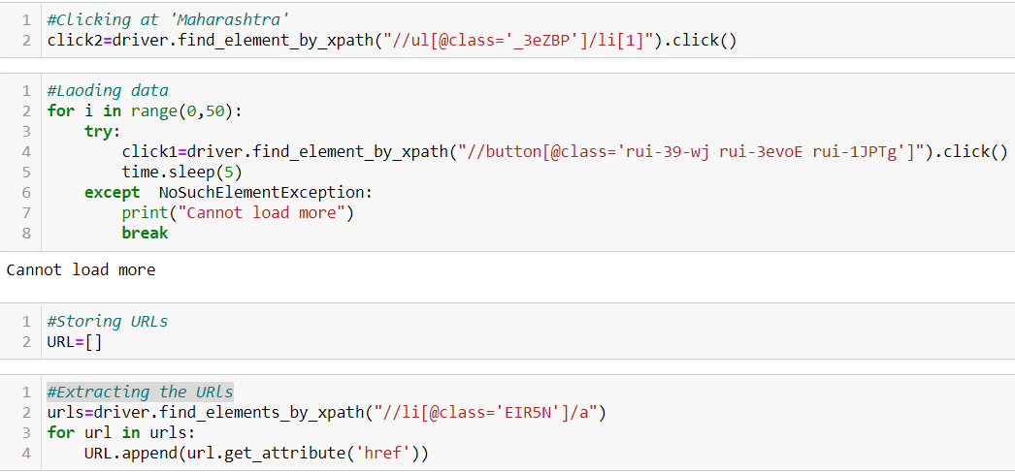
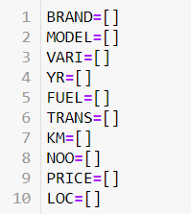
Data scrapping
Loading library and connecting to web driver
Loading pages and extracting Urls and saving it in the list URL.
Creating lists to save the scrapped data from urls.

Slide 4
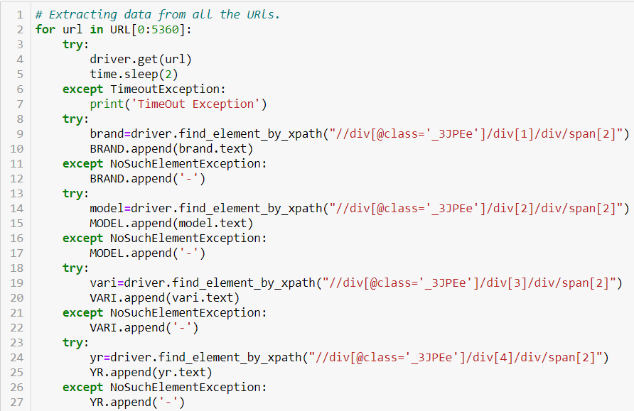
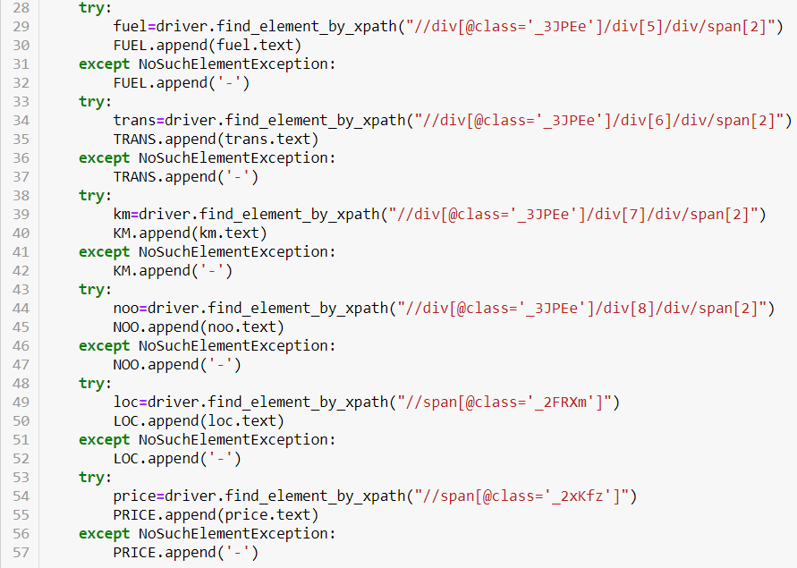
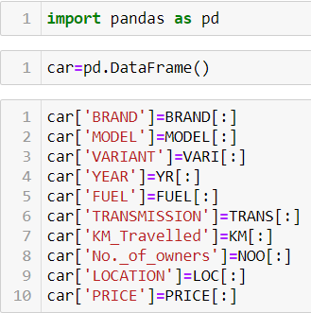
Extracting required data from all Urls and saving it in respective lists.
Creating data frame and storing data from lists into the data frame ‘car’

Slide 5
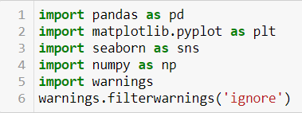

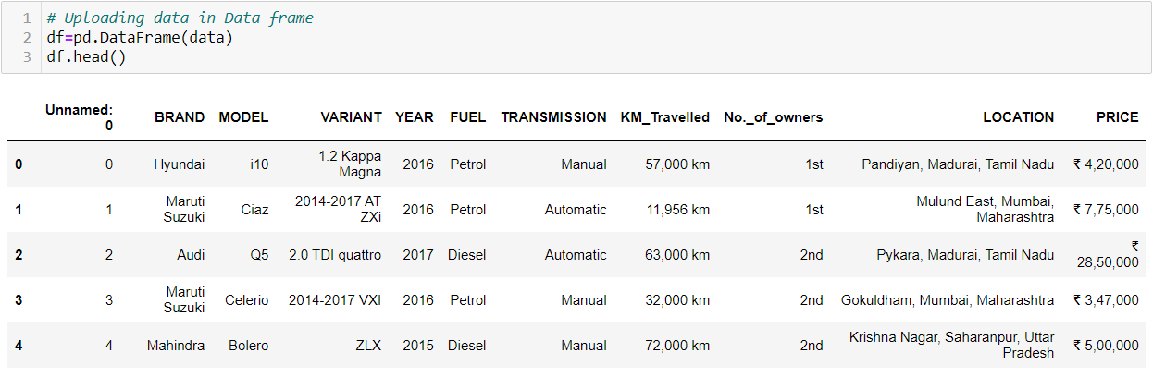
Steps Followed: (1) Loading data
Loading libraries
Uploading data from ‘cars.csv’
Loading data into data frame ‘df’

Slide 6
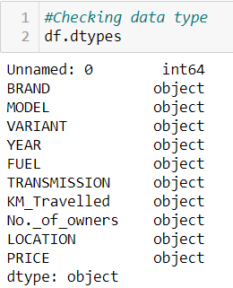

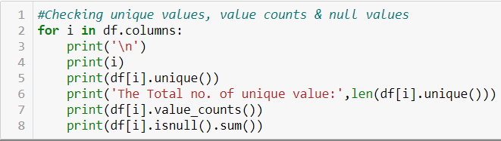
(2): Understanding data
‘Unnamed: 0’ variable is integer type and all other variable is string type
There is no duplicated rows.
There is no nan values in the data.
There are few ‘-’ entries in the data
Some data have been mixed up in columns.

Slide 7





(3): Cleaning the data
Since ‘Unmaed: 0’ variable have all unique values as it is just an index number, we can drop it.
We will keep the rows having the values -: 'Petrol', 'Diesel', 'CNG & Hybrids', 'LPG', ‘Electric' and drop all other rows having different values.
We will keep the rows having the values -: 'Manual', 'Automatic' and drop all other rows having different values.
Removing rows having ‘-‘as value
Renaming few values in ‘YEAR’ variable to correct it
We keep only those values which have frequency greater than 20.
We keep only those values which have frequency greater than 10.

Slide 8
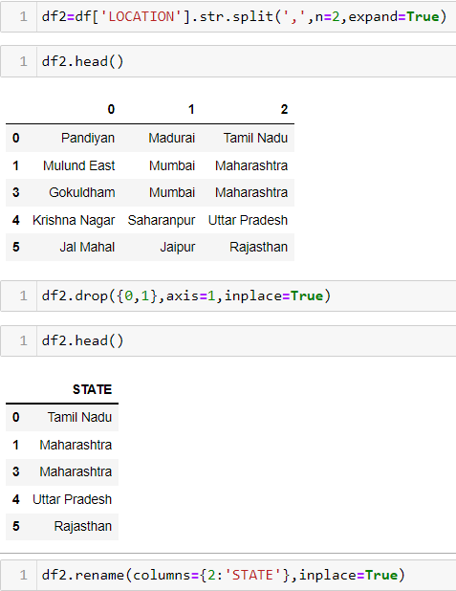
Since ‘VARAINT’ variable have 1650 unique values, we have to drop it.
Splitting location into locality, city & state.
Keeping state and dropping locality & city.
Removing '₹' and ',' from ‘PRICE’ variable
Removing ',' and 'km' from 'KM_Travelled' variable.

Slide 9
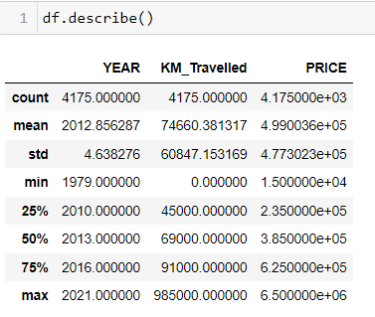
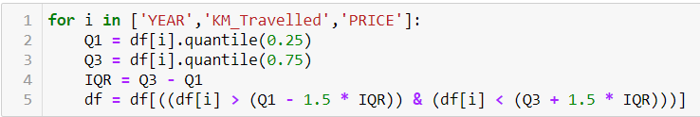
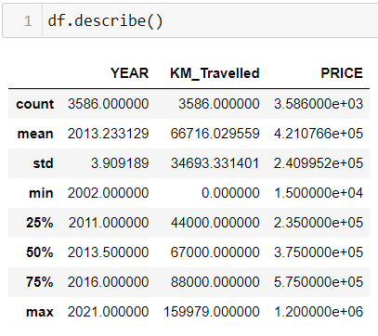
(4): Treating outliers
There are outliers present in ‘YEAR’, ‘KM_Travelled’, ‘PRICE’. KM_Travelled & PRICE is right skewed.
We apply IQR on the above columns
Outliers reduces. Skewness reduces.

Slide 10
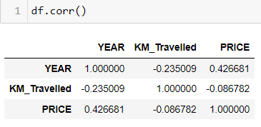
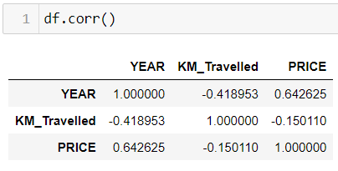
(5): Finding correlation
Correlation before outliers removal
YEAR has a good correlation of above 42% with target variable.
KM_Travelled has a poor correlation of above 8% with target variable.
Correlation after outliers removal
Correlation of YEAR with target variable improved to above 64%.
Correlation of KM_Travelled with target variable improved to 15%.

Slide 11
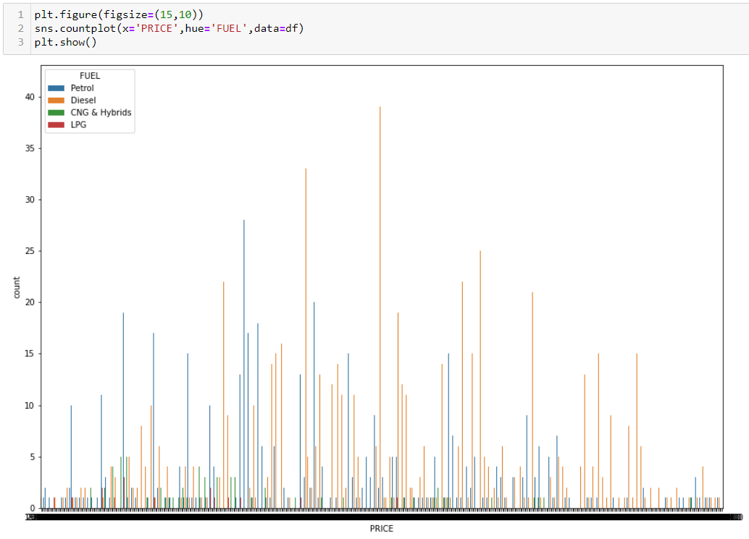
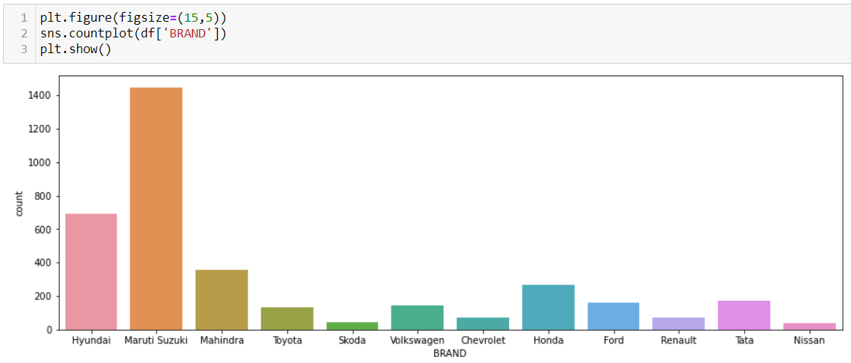
(6): Graphical Analysis
Diesel run used car frequency count increase as compare to petrol run used car with increase in price
Maruti Suzuki Brand car are more available for resale in market, followed by Hyundai

Slide 12
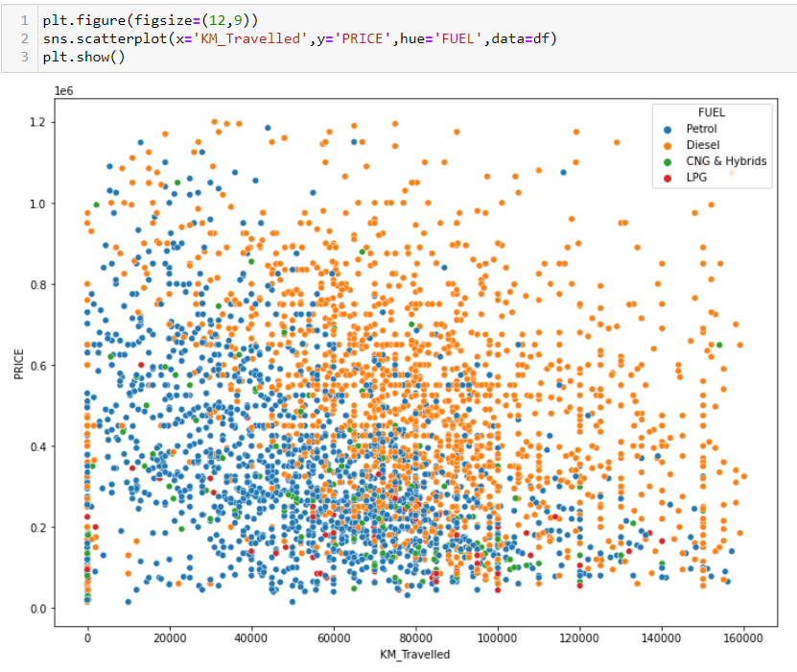
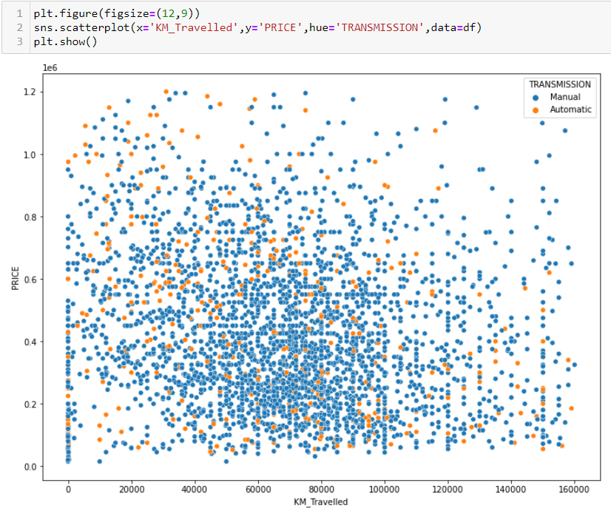
1) Diesel run car have travelled more kilometres than petrol run cars.
2) High priced and more kilometres travelled car are mostly diesel run only.
3) High priced car density decreases with increase in kilometres travelled.
Automatic transmission show a faint inverse linear relation with price and kilometre travelled

Slide 13
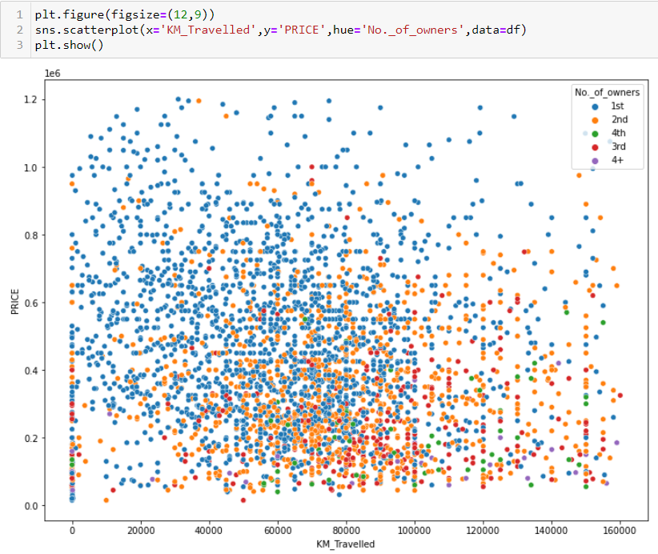
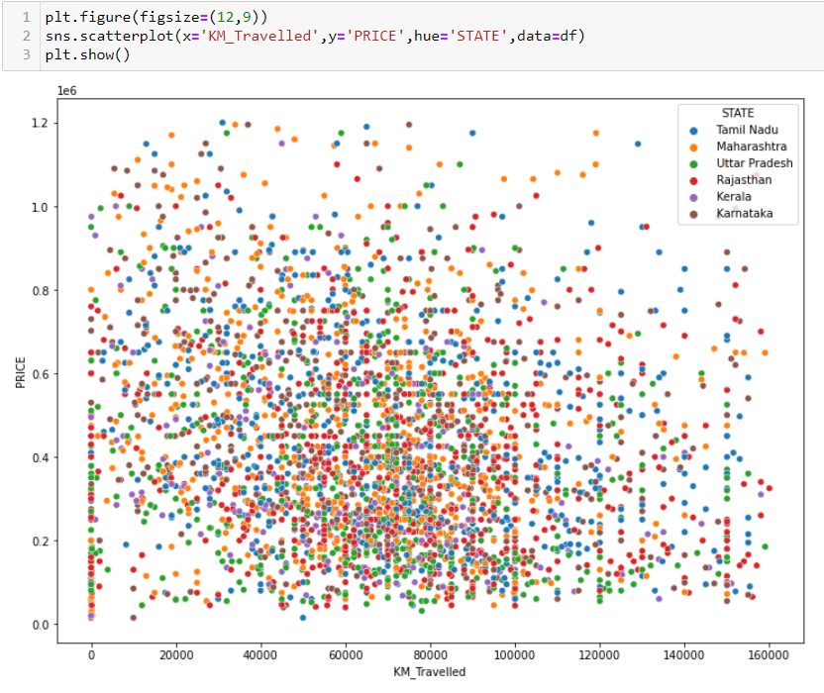
1)With increase of no. of owners, the distance travelled also increase .Thus; they have linear relationship between them.
2) First owner used car are at higher price than others.
STATE shows no relation with price of car, thus we can drop the column.

Slide 14
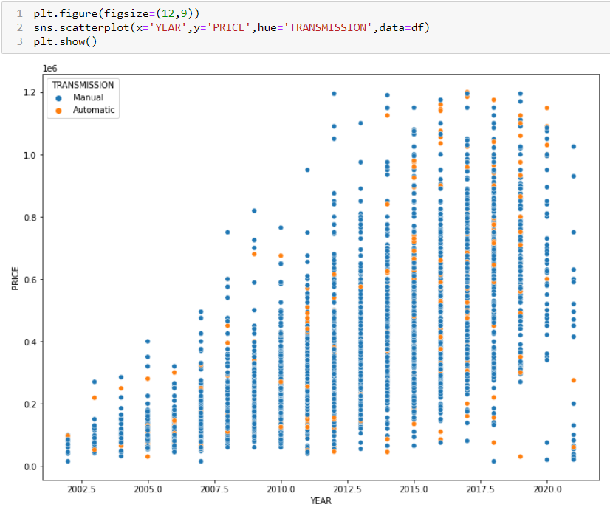
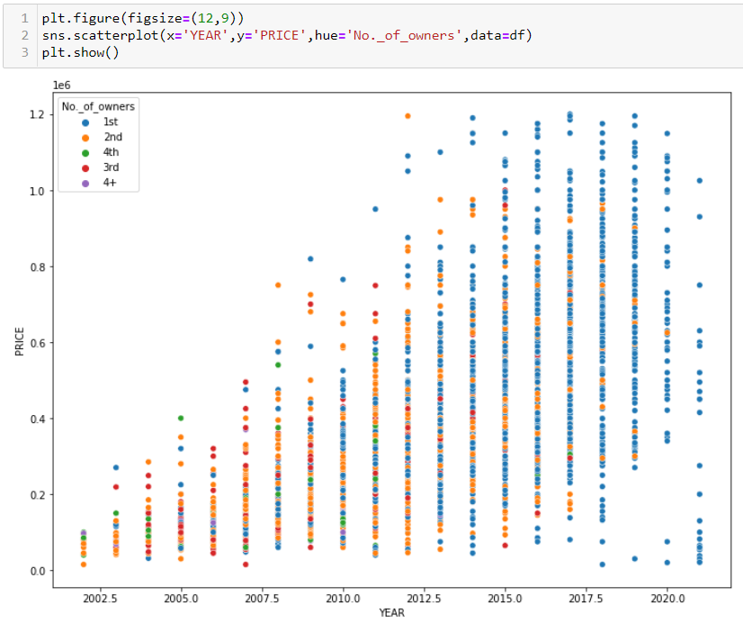
YEAR shows a slight linear relation with PRICE
We observe that from 2015, comparatively more first owned used cars are available for re-sale. Thus we can interpret that people are not interested of selling/buying second owned hand cars.

Slide 15
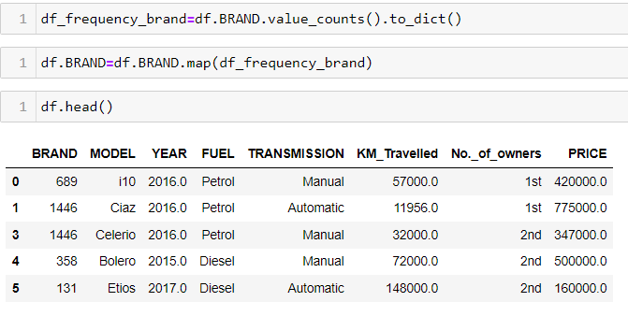
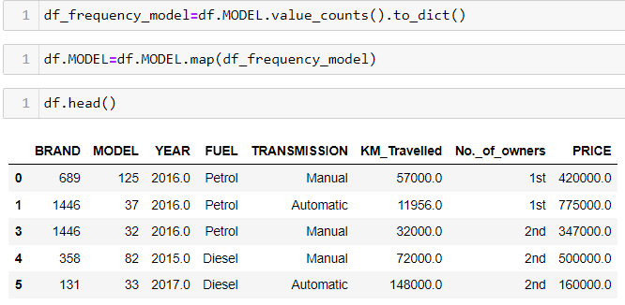
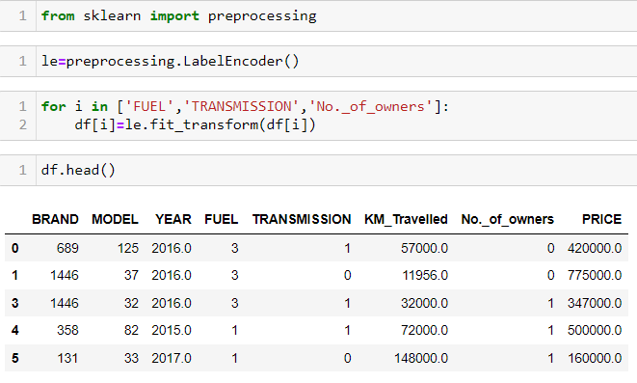
(7): Treating multi-class data
We replace the values in BRAND with the number of its frequency count
We replace the values in MODEL with the number of its frequency count
We replace the values in FUEL, TRANSMISSION & No._of_owners with 0,1,…

Slide 16

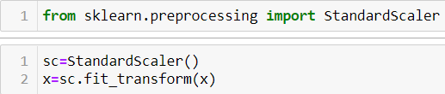
(8) Standardization of data
We separate the target variable from data frame and store the remaining in x.
We store the target variable in y.
We use Standard Scaler function on x, to standardized all its value.

Slide 17
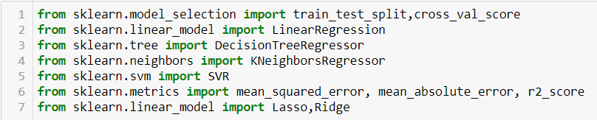
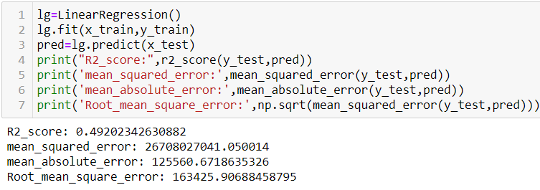
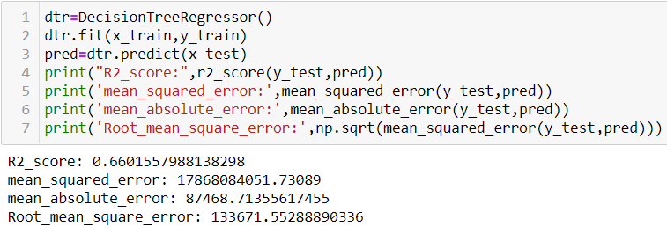
(9): Model Selection
Importing algorithm from libraries .
Splitting the data
Linear Regression
Decision Tree Regression

Slide 18
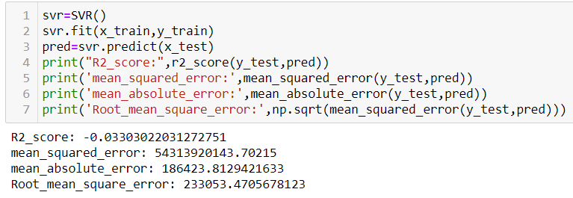
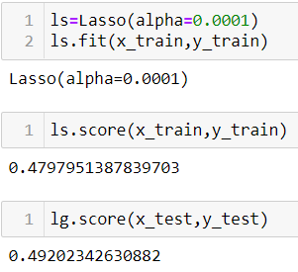
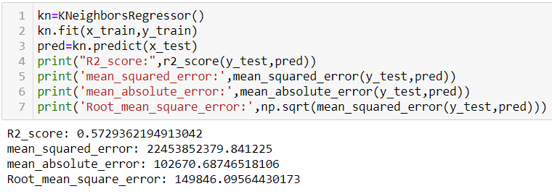
Support Vector Regression
Lasso Regression
K-Nearest Neighbors
Thus, we can observe DTR() gave the best R2 score of 66% and minimum MAE,MSA,RMSE

Slide 19
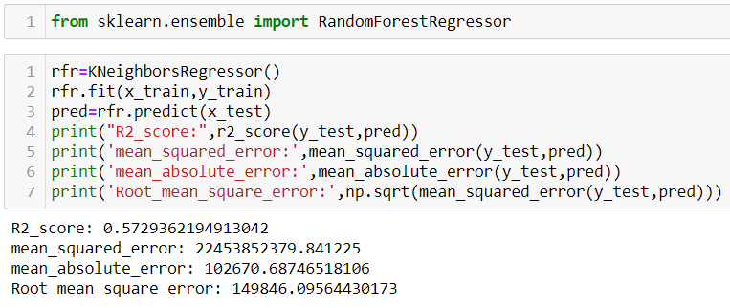
(10): Ensemble Technique
Random Forest Regressor

Slide 20
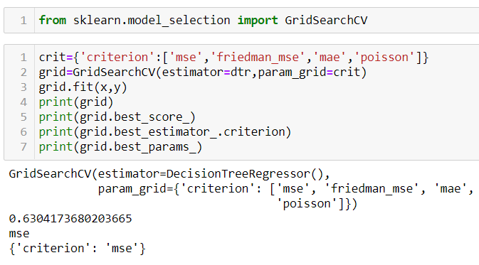
(11): Hyper Parameter
We apply GridSearchCV() with estimator DTC() and criterion mean squared error.

Slide 21
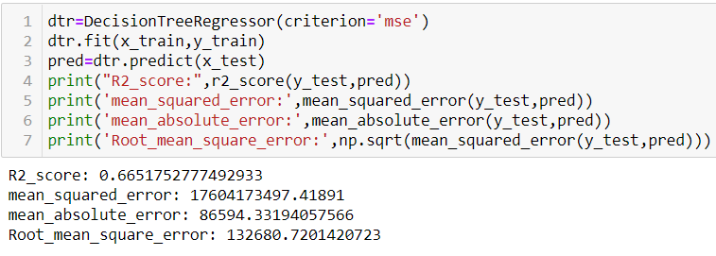
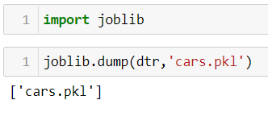
(12) Saving the best model
Saving Decision Tree Regressor as best model with 66.5% R2score

Slide 22
(13) Conclusion

Slide 23
(13) Conclusion
The Key observation from the projects are:-
1) Maruti Suzuki is the most available used car for resale in OLX.
2) Maximum used car run on petrol & diesel only.
3) Car with Manual transmission are five times more than car with automated transmission.
4) From 2015, comparatively more first owned used cars are available for resale. Thus we can interpret that people are not interested of selling/buying second owned used cars.
5) Cost of car does not depend on state.
6) Diesel run used car are costlier than petrol run used car
7) Diesel car is used for longer distance travel than petrol car.
8) Older cars have comparatively lesser resale value than newer car.

Slide 24
THANK YOU !!!

